Slide 1
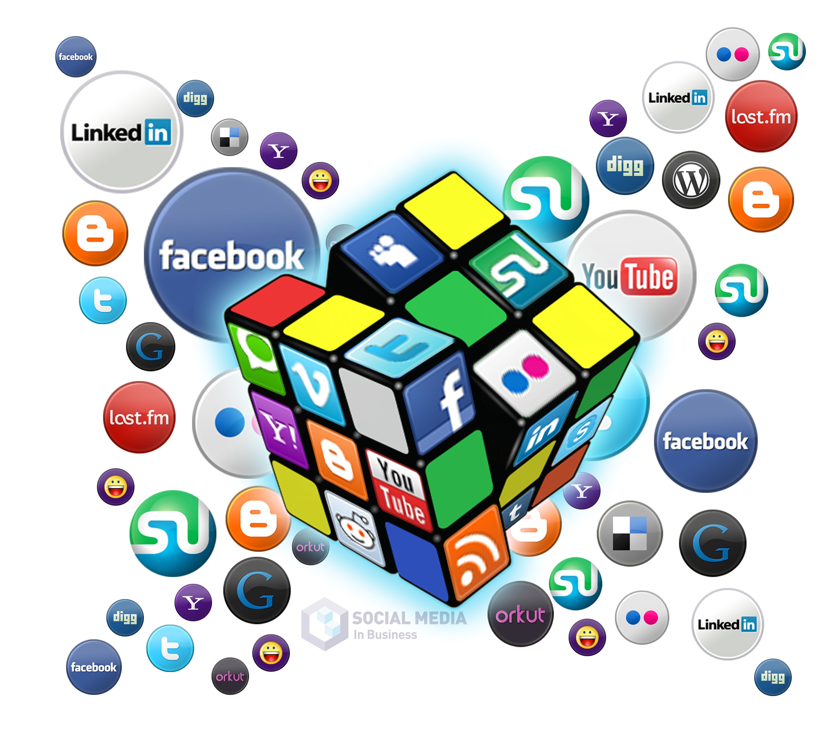
Social Media Strategy: Building it from Scratch
Week 2
Week 1: Generating Knowledge and AI Integration for Use in Social Media| Thursday, April 18th from 9 am – 11 am
Week 2: Creating a Presence on Social Media | Thursday, April 25th from 9 am – 11 am
Week 3: Content Marketing Management, Creation, & Analysis | Thursday, May 2nd from 9 am – 11 am
Week 4: Digital Marketing Options for Social Media Marketing, AI Tools and Resources | Thursday, May 9th from 9 am – 11 am
Kellie Emrich
Kellie.emrich@tri-c.edu

Slide 2
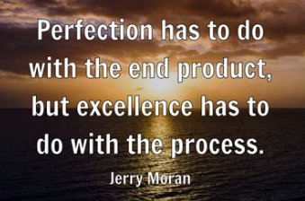
How the Sessions Will Work
Branding and Goal Setting
Business and Competitor Audit
Listening and Research
Creating and Reaching Target Audiences
Social Media Platforms and Strategies
Content Marketing
Analytics
Process for Creating a Social Media Strategy During These Sessions

Slide 3
Week 2 – Reaching Target Audiences Creating a Presence on Social Media
THE Golden Circle
Generating Buyer Personas
Benefits vs. Features
Creating Content for Buyer Personas

Slide 4
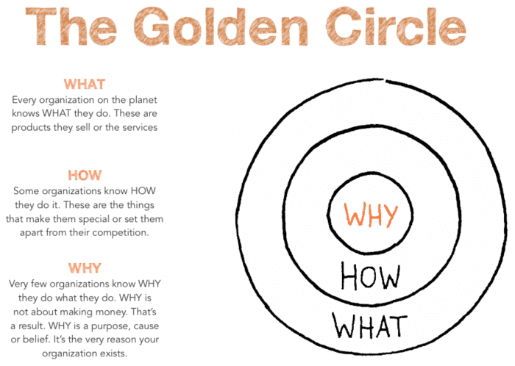
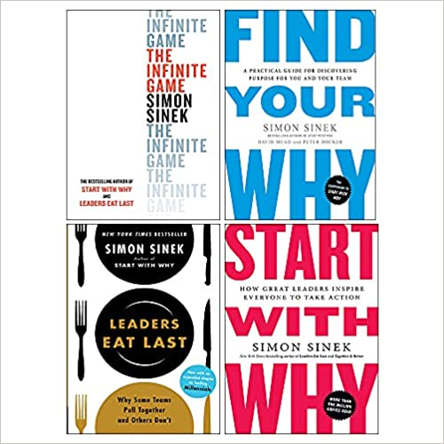
Simon Sinek
https://www.youtube.com/watch?v=GaGsw1MFgk8

Slide 5
Buyer
Personas

Slide 6
What Is a Buyer Persona?
A buyer persona is not about describing the business’s potential purchasing audience, but about generating a set of insights that can be used by marketing, sales, and product departments to make informed decisions and smarter investments.
Why are Buyer Personas/Target Markets so important for Social Media?
You want to know as much about them as possible so that you can provide personalized service, relevant content, and helpful sales information.

Slide 8
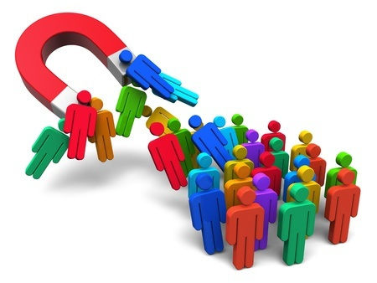
Creating Target Markets with AI
https://chat.openai.com/
https://claude.ai/
https://www.perplexity.ai/
Build a persona for a Marketing Director of a non-profit in the Midwest US with a mission to provide better access to healthcare resources in under-served communities. The goals of this person are to create more effective fundraising campaigns through digital marketing and to promote their events.
Follow-up questions
What words does this person use to describe their marketing challenges and solutions?
What kinds of things might happen that make this person realize that they need help?
What information about the business would they need before contacting them about your products or services?
Which of their top concerns are not addressed on this webpage? [copy and paste in a webpage]
List their hopes/dreams, fears/concerns, emotional triggers, and decision criteria
What type of lifestyle would someone have if they were in the market for [product/service]?
What are the common pain points that someone might have, who is looking to purchase [product/service]?
What are the values, interests, and hobbies of the individuals who would buy [product/service]?
review the AI-generated persona and make necessary corrections based on your knowledge of the audience.
Review the AI-generated persona and make necessary corrections based on your knowledge of the audience.
Use follow-up questions to clarify or expand on any answers. How, when, why, where
Save this Chat and continue to use and build from the responses.

Slide 9
Creating Target Markets with AI
Remember, AI is just a tool to help spark creativity and generate ideas quickly. The real value comes from your ability to refine and develop those ideas into compelling content that resonates with your audience.

Slide 10
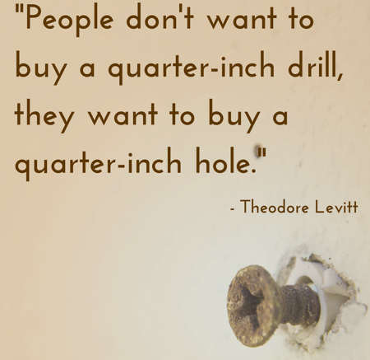
Preparing Content Talk Benefits, Not Features
People don’t care about the tool; they just want to get a benefit.
They don’t want to read books; they want to get information from them.
Not a wellness solutions, instead having more energy.

Slide 11
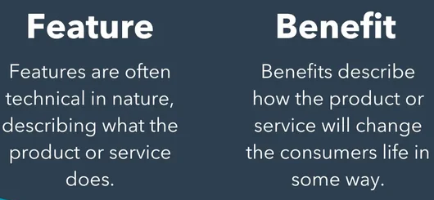
The 3 Main Types of Benefits Buyer Personas Look for
Functional benefits: Think of it as what the product does for the customer. Examples include ease of installation or reliability, such as a car’s fuel efficiency or software compatibility with existing systems.
Symbolic benefits: It's more about how the product or service makes them feel about themselves or how they believe others will perceive them. Ex. successful, sophisticated, environmentally conscious, or part of a desirable group.
Experiential benefits: They're about creating a pleasant emotion, such as excitement, empathy, comfort, or nostalgia. Even products as simple as cinnamon rolls can evoke positive experiential benefits.

Slide 12
Writing Content for Social Media
Talk Benefits, Not Features
Know your How and Why and talk about them
Create content for all parts of the buying process – 80/20 Rule
Engage with your audience
Create content about the result your target audience wants to receive
Headlines and short sentences
Hashtags and mentions
Visuals
You, it’s a powerful word, Imagine
Use numbers
Ask a question
Create urgency
Trigger curiosity or emotion
Special characters and emojis - Trick! ☀
Hashtags
Line breaks
Quotes
Calls to Action

Slide 13
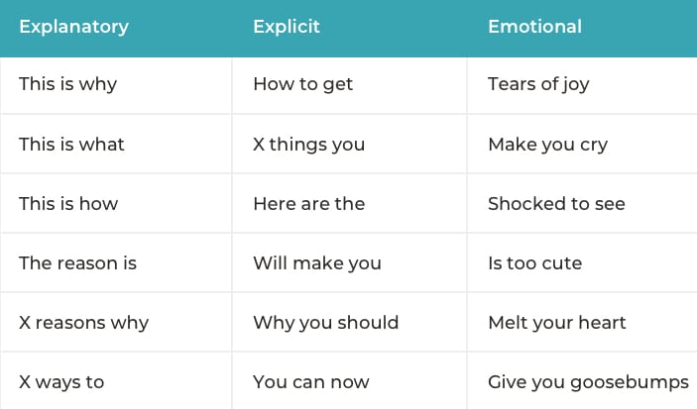
Writing Content for Social Media
Power trigrams
Steve Rayson’s research on 100 million headlines has decrypted the psychology of social media users. It gives us a powerful cheat sheet for word choices. Steve discovered which trigrams (three-word combinations) appear most often in the most

Slide 14
Tell Stories When Possible
Use Stories, from a single person perspective
“Our safe room against burglars has helped out thousands of people feel secure and safe.” This sentence doesn’t really appeal to anyone or strike at any emotion.
On the other hand, a story about a single person just might.
“John was sleeping one night at home with his wife and his newborn infant. Suddenly, he heard a noise from the kitchen. He immediately woke his wife up, ran to his kid, and they locked themselves in the safe room from where they called the police. The police came within five minutes and apprehended the burglars. John kept his family safe by using one of our safe rooms.”
Suddenly, we care. Talk about the experience of a single person and paint the picture.

Slide 15
How do you Find Content?
Feedly
Google Alerts Google Trends
https://chat.openai.com/
https://claude.ai/
https://www.perplexity.ai/
Your Competition’s
Social Media Sites
Hashtags
Groups Organizations
Your own Expertise
Content Library

Slide 16
End of Session 2
Homework:
Create Buyer Personas/Target Audiences using AI
Save each persona in CHAT GPT and continue to use the same chat
Analyze the results and transfer desired data into the Social Media strategy worksheet

Slide 17
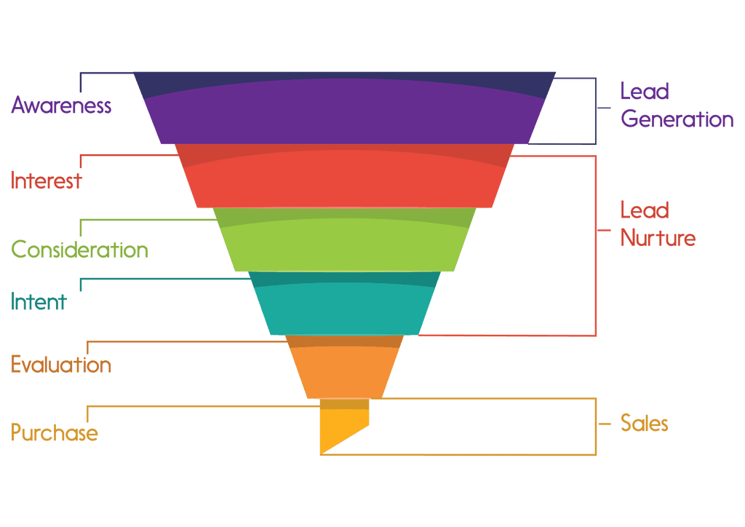
Match content to buyer personas and sales funnel

Slide 18
Writing Content for Your Buyer Persona Creating Empathy with your Buyer Persona Create Statements from the Viewpoint of your Persona
When Buyer Persona ___ (the problem of your potential customer)
that’s why Buyer Persona wants ___ (the solution you can offer to him/her)
so, Buyer Persona can ___ (a state or a result he/she wants to achieve).
For example: When Joe works, He spends too much time completing all his tasks, that's why Joe wants to find a tool to improve time management, so Joe can spend more time with his family.
Make the Content About JOE!

