Slide 1
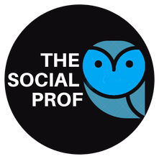
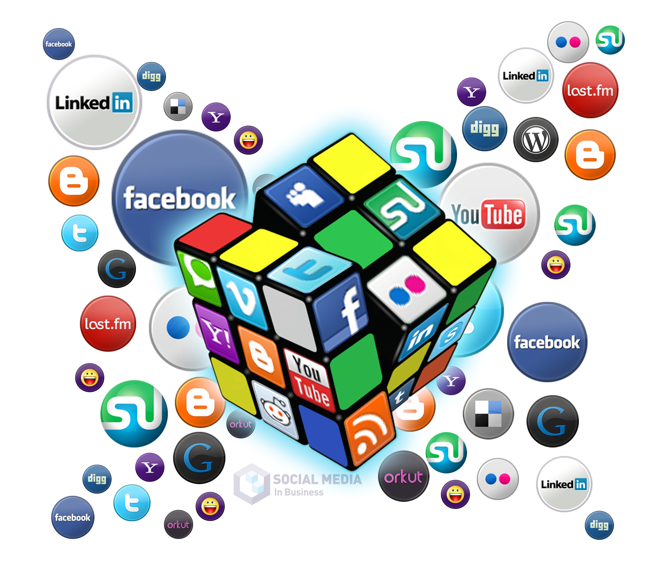
Social Media Strategy: Building it from Scratch
Overview of the 4 Weeks
Week 1: Generating Knowledge and AI Integration for Use in Social Media| Thursday, April 18th from 9 am – 11 am
Week 2: Creating a Presence on Social Media | Thursday, April 25th from 9 am – 11 am
Week 3: Content Marketing Management, Creation, & Analysis | Thursday, May 2nd from 9 am – 11 am
Week 4: Digital Marketing Options for Social Media Marketing, AI Tools and Resources | Thursday, May 9th from 9 am – 11 am
Kellie Emrich
Kellie.emrich@tri-c.edu

Slide 2
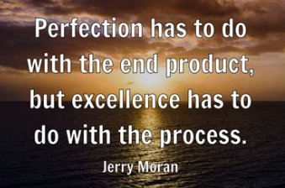
How the Sessions Will Work
Branding and Goal Setting
Business and Competitor Audit
Listening and Research
Target Audiences
Social Media Platforms and Strategies
Content Marketing
Analytics
Process for Creating a Social Media Strategy During These Sessions

Slide 3
Introductions
LinkedIn
LinkedIn has over 1 Billion members
https://www.linkedin.com/in/kellieemrich/
More than 67 million companies use LinkedIn for business.
LinkedIn saw a 55% increase in conversations among connections in 2023
Content creation on LinkedIn increased by 60% in 2023
LinkedIn is the #1 Research Tool for Professional Connections
Helpful Links
https://www.linkedin.com/company/linkedin/
https://www.linkedin.com/pulse/linkedin-entrepreneurs-leveraging-platform-startup-success/

Slide 4
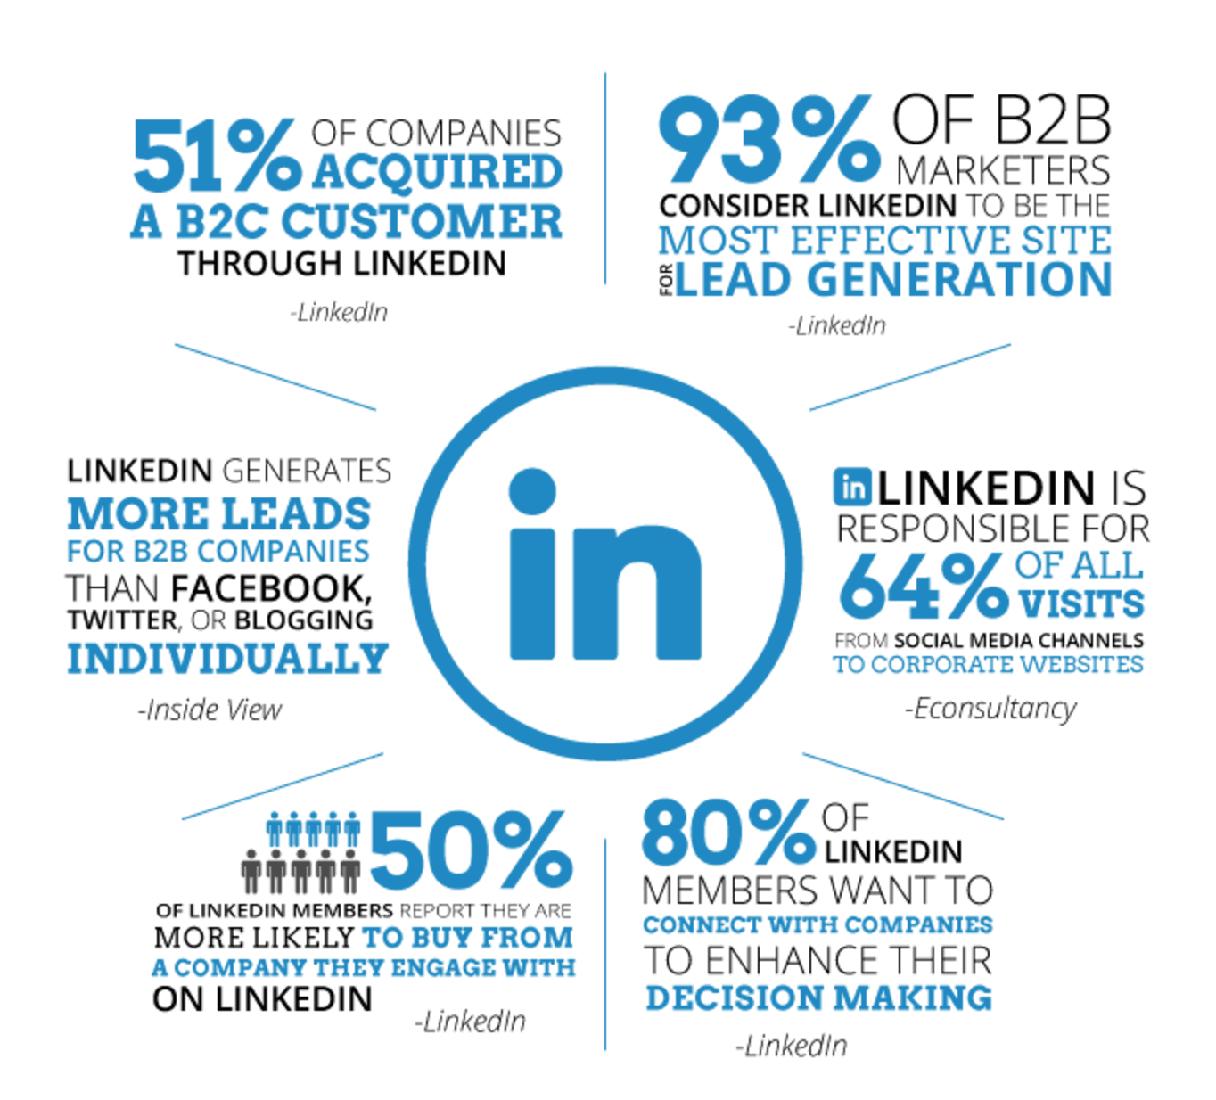
Introductions
LinkedIn
LinkedIn has over 1 Billion members
https://www.linkedin.com/in/kellieemrich/
More than 67 million companies use LinkedIn for business.
LinkedIn saw a 55% increase in conversations among connections in 2023
Content creation on LinkedIn increased by 60% in 2023
LinkedIn is the #1 Research Tool for Professional Connections
Helpful Links
https://www.linkedin.com/company/linkedin/
https://www.linkedin.com/pulse/linkedin-entrepreneurs-leveraging-platform-startup-success/

Slide 5
How the Sessions Will Work
Branding and Goal Setting
Business and Competitor Audit
Listening and Research
Target Audiences
Social Media Platforms and Strategies
Content Marketing
Analytics
Process for Creating a Social Media Strategy During These Sessions

Slide 6
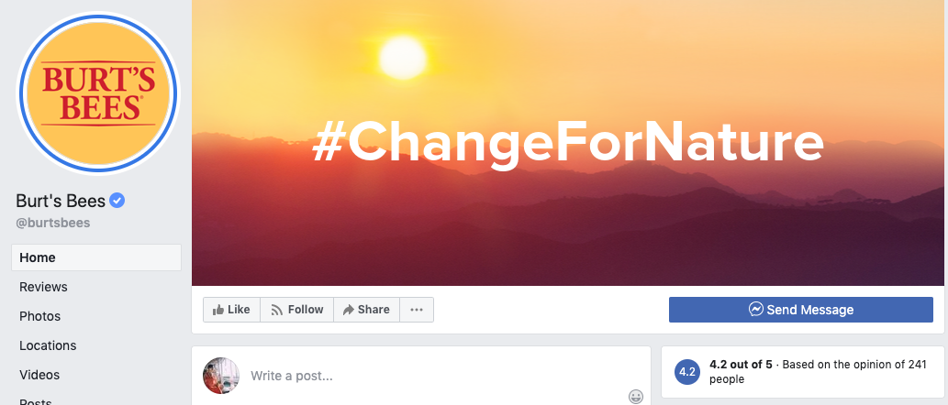
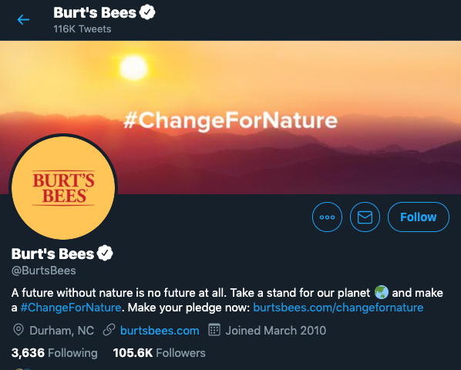
BRANDING
Why is Branding so Important in a Social Media Marketing Strategy?
The digital landscape is crowded. It’s filled with chatter from brands and individuals. Finding consistent and unique patterns is essential.
By maintaining your fundamental beliefs across content, advertising and social media posts, you create similar experiences.
A brand is how you make your customers feel, and it’s built by taking a consistent approach across every interaction an audience has with your brand.
Example
https://www.facebook.com/burtsbees/
Another Example: https://www.instagram.com/seejanework/

Slide 7
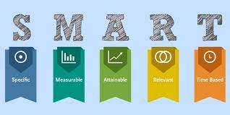
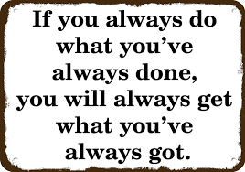
Creating Social Media Goals
Points to what is working and what is not
Shows the value of your social media work
Aligns Marketing and Business Strategies
Keep up with algorithm changes

Slide 8
Example Social Media Goals
Increase Brand Awareness: Aim to grow the number of followers and engagement on social media platforms by a certain percentage over a specific period, such as 30% in the first six months. This can help more potential customers discover the business.
Boost Engagement: Set a goal to increase likes, comments, shares, and overall interaction with your posts. For example, double the engagement rate in three months by implementing interactive content.
Increase Reach – The number of people seeing your content/posts. Aim for 10% growth in reach for the first 3 months.
Drive Website Traffic: Use social media posts to direct traffic to the business's website. A measurable goal could be to increase referral traffic from social media by 25% within the first quarter.
Generate Leads: Focus on converting followers into leads by promoting sign-ups through social media-specific offers. Aim for a specific number of new leads per month, such as 20 new leads in the first three months.
Increase Sales: Target a specific number of sales directly attributed to social media campaigns, such as selling 200 units of a product within the first month of launch through exclusive social media promotions.
Build a Community: Aim to build a loyal community around your brand. Set a goal to have a certain number of active members in your social media groups or forums within six months.
Improve Brand Loyalty: Plan to post regular updates and customer stories that highlight the uniqueness of your brand, aiming to increase customer retention rates by 10% through social media interactions.

Slide 9
How the Sessions Will Work
Branding and Goal Setting
Business and Competitor Audit
Listening and Research
Target Audiences
Social Media Platforms and Strategies
Content Marketing
Analytics
Process for Creating a Social Media Strategy During These Sessions

Slide 10
Audit Social Media for Your Business and Competitors
Social Media Audit of Your Business
Before you create a social media marketing plan, it’s important to conduct a social media audit. Taking stock of your current social media accounts and networks, as
well as the number and efficacy of users and owners, will help you understand what efforts are working—and what is not. You can then pare down on inactive accounts, give permissions to responsible users, and begin your strategy with a clean slate.
Conduct a Competitive Analysis
A competitive analysis allows you also understand your competitor’s social presence and what they’re doing well (and not so well). You’ll get a good sense of what’s expected in your industry, which will help create social media goals of your own. It will also help you spot opportunities.

Slide 11
Social Media Audit – Business, Industry, Competitors
Wrangle all of your existing social media profiles
As you audit your social presence, make a point to double-check that your profiles “match” when it comes to creatives, promotions and campaigns. This includes:
Bio and “About” language (when in doubt, refer to your style guide)
Profile and banner images
Destination URLs and landing pages
Identify your top-performing social media posts
Make sure your branding, promotions and language are consistent
Understand your own social media presence and that of your competitors and industry leaders. What works and what does not? Note any opportunities and themes.

Slide 12
How the Sessions Will Work
Branding and Goal Setting
Business and Competitor Audit
Listening and Research
Target Audiences
Social Media Platforms and Strategies
Content Marketing
Analytics
Process for Creating a Social Media Strategy During These Sessions

Slide 13
Research and Listening On Social Media
80% of social media marketing is providing content, and it’s imperative you intimately get to know your audience.
Researching and listening is the first step in social media marketing
Provides intelligence and insight into industry and potential customers
You then develop a social media strategy with relevant, personalized, and engaging content
Social listening allows you to track and analyze conversations about your audience, and industry online.
To solve problems
To find out what they care about
To discover what information, they need
What they are responding to and asking about
Understand behaviors and trends
Research Competitors

Slide 14
Social Listening with www.feedly.com Social Listening is an important aspect of your social media plan. Social listening = knowledge. Knowledge about your audience, industry, competitors, and content. Social listening allows you to stay updated on your industry, understand your target audience, find content to see what is and is not working, and understand what your potential audience is talking about
To create a Feedly account go to www.feedly.com and click the GET STARTED FOR FREE button. You can sign up for Feedly with an existing Facebook or Google account. Alternatively, you can continue with Feedly and register a new account. C
Check email for verification message.
Once logged in click on “Add Content” then “Publications and Blogs” to get started adding content.
For more help watch this short Video - https://www.youtube.com/watch?v=vn3k3x9L5uA
To get started only listen up to the 4-minute mark.
Note - Feedly is an RSS Feed (Really Simple Syndication) that brings information from all over the web into one location. Feedly is recommended because it is free and easy to use.

Slide 15
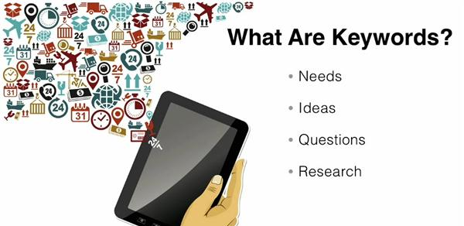
Keywords
Word's people type into search engines
like Google, and the search boxes on social media platforms to find the content they are looking for.
Ask - What would your customer type in a search box if they were looking for our product or service?
Using the right Keywords in your content means higher visibility– On search engines and social media platforms
Resources – Google Chrome Extension – Keyword Surfer
SEMrush
Google Keyword Planner
https://trends.google.com/trends/?geo=US
https://answerthepublic.com/

Slide 16
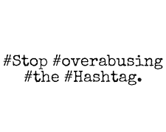
Hashtags # - the pound sign (or hash) turns any word or group of words that directly follow it into a searchable link.
Hashtags
No Spaces, If you want to differentiate between words,
use capitals instead.
Numbers are supported; however, punctuation marks are not.
Hashtags are used on Twitter, Facebook, Instagram, Pinterest, Tumblr
There is no preset list of hashtags. Create a brand-new hashtag simply by putting the hash before a series of words, and if it hasn't been used before, voilà! You've invented a hashtag.
Hashtags are used for 2 reasons
1. To Emphasize - #howcool #sadness, #heretohelp
2. To reference/organize content in one place –
#clevelandohioevents, #CityClub, #GeonNewsletter
Notes:
Keep in mind that the @ symbol does something completely different. Using @ before a person’s username/handle will post to them directly, letting them know you have written to them via the @Connect tab. A hashtag will not. Sometimes users will hashtag a celebrity’s name instead of using their @Handle/username — it is acceptable to tweet #Lorde or @lordemusic. But if you are trying to reach someone directly, don’t use a hashtag.

Slide 17
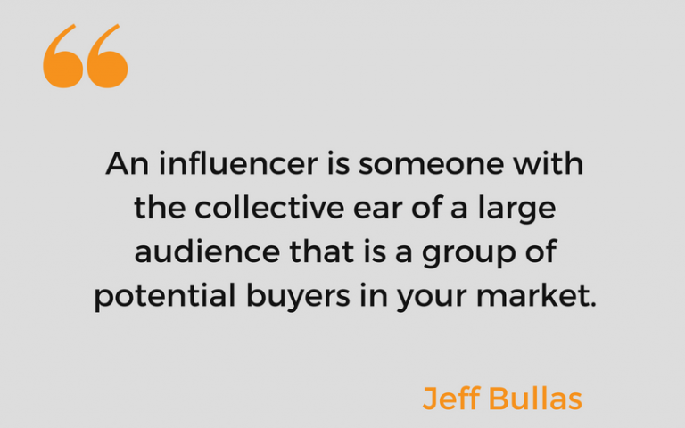
Influencers
A Social Media Influencer is a user on social
media who has established credibility in a specific
industry. They have access to a large audience
and can persuade others by virtue of authenticity
and reach.
Influencers integrate products and services into their lives just like
the rest of us, making what they promote seem special, but also relatable.
For example, if you’re trying to find a social media influencer on grilling and barbecuing, you’ll want people such as:
Food critics in the industry
People with popular outdoor cooking Instagram accounts
Grilling bloggers who write for major recipe sites
Grill and barbecue pit builders
Ribs and barbecue contest judges

Slide 18
Start your www.Feedly.com account
Fill out the social media audit for your business.
Find at least 3 competitor on social media. What are they doing well and not well.

Slide 19
https://chat.openai.com/
Conduct research on industry trends or competitors. Prompt: Can you gather information on the latest trends in digital marketing? [Specify the specific aspect or subtopic in digital marketing you're interested in]
Assist with customer support inquiries. Prompt: Can you help me respond to a customer's support ticket about a billing issue? [Provide necessary details like the customer's name and the specific issue]
Assist with content creation for marketing materials. Prompt: Can you help me write engaging copy for our upcoming product brochure? [Provide any specific details or key features that should be highlighted]
Assist with market research and competitor analysis. Prompt: Can you help me gather information on our top competitors and their marketing strategies? [Specify the industry or market segment and any key competitors]
Assist with social media management and scheduling. Prompt: Can you help me schedule our social media posts for the upcoming week? [Specify the social media platforms and any specific content or hashtags to include]
Assist with market segmentation and target audience analysis. Prompt: Can you help me identify and define our target audience for a new product launch? [Specify any specific demographics or psychographics to consider]
Assist with creating and managing a content calendar for social media. Prompt: Can you help me create a content calendar for our social media platforms for the next quarter? [Specify the desired posting frequency and any key events or promotions]

